Slide 1
CSDS 451: Designing High Performant Systems for AI
Lecture 10
9/25/2025
Sanmukh Kuppannagari
sanmukh.kuppannagari@case.edu
https://sanmukh.research.st/
Case Western Reserve University

Slide 2
Outline
Convolution as Matrix Multiplication – Motivation
Im2Col and Kn2Row Algorithms
Scalar Matrix Multiplication Algorithm

Slide 3
Reading Materials
Papers on Im2Col, Implicit Im2Col
Original Im2Col: Chetlur, S., Woolley, C., Vandermersch, P., Cohen, J., Tran, J., Catanzaro, B., & Shelhamer, E. (2014). cudnn: Efficient primitives for deep learning. arXiv preprint arXiv:1410.0759.
Implicit Im2Col Nvidia Doc: https://docs.nvidia.com/deeplearning/performance/dl-performance-convolutional/index.html
Implicit Im2Col: S. Lym, D. Lee, M. O’Connor, N. Chatterjee, and M. Erez, “Delta: Gpu performance model for deep learning applications with in-depth memory system traffic analysis,” in 2019 IEEE International Symposium on Performance Analysis of Systems and Software (ISPASS). IEEE, 2019, pp. 293–303
Implicit Im2Col: Zhou, Yangjie, et al. "Characterizing and demystifying the implicit convolution algorithm on commercial matrix-multiplication accelerators." 2021 IEEE International Symposium on Workload Characterization (IISWC). IEEE, 2021.

Slide 4
Reading Materials
Kn2Row: Vasudevan, A., Anderson, A., & Gregg, D. (2017, July). Parallel multi channel convolution using general matrix multiplication. In 2017 IEEE 28th international conference on application-specific systems, architectures and processors (ASAP) (pp. 19-24). IEEE.
Scalar Matrix Multiplication: Ofir, A., & Ben-Artzi, G. (2022). Smm-conv: Scalar matrix multiplication with zero packing for accelerated convolution. In Proceedings of the IEEE/CVF Conference on Computer Vision and Pattern Recognition (pp. 3067-3075).

Slide 5
Outline
Convolution as Matrix Multiplication – Motivation
Im2Col and Kn2Row Algorithms
Scalar Matrix Multiplication Algorithm

Slide 6
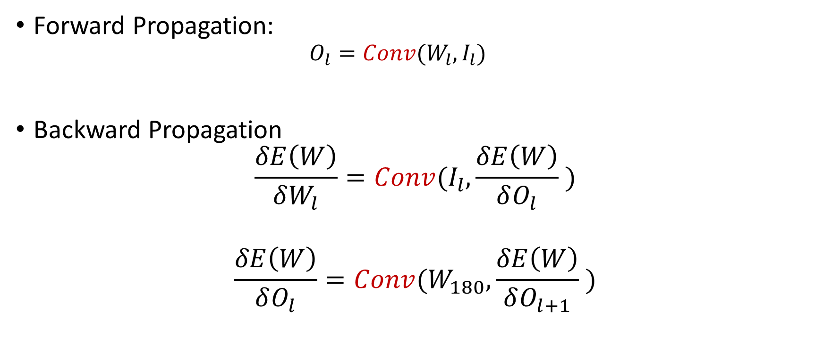
Key Operation in CNN
Forward Propagation:
$$O_{l}=Conv(W_{l}, I_{l})$$
Backward Propagation
$$\frac{δE\left(W\right)}{δW_{l}}=Conv(I_{l},\frac{δE\left(W\right)}{δO_{l}} )$$
$$\frac{δE\left(W\right)}{δO_{l}}=Conv(W_{180},\frac{δE\left(W\right)}{δO_{l+1}} )$$

Slide 7
CNN on A100 Roofline Plot (assuming infinite cache)
Memory Bound
Compute Bound
Peak
Performance
Sustained Performance
(ops/sec)
75
Arithmetic Intensity
Which area will the CNN Performance lie in? Compute Bound

Slide 8
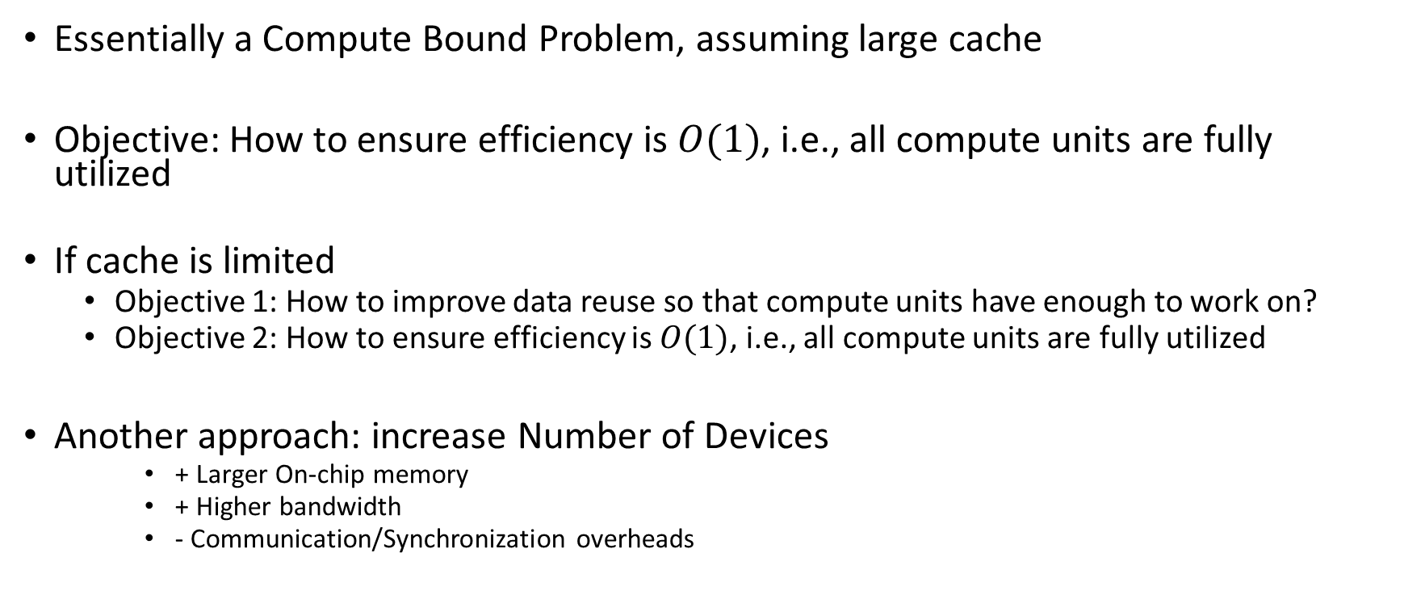
Implications
Essentially a Compute Bound Problem, assuming large cache
Objective: How to ensure efficiency is $O(1)$, i.e., all compute units are fully utilized
If cache is limited
Objective 1: How to improve data reuse so that compute units have enough to work on?
Objective 2: How to ensure efficiency is $O(1)$, i.e., all compute units are fully utilized
Another approach: increase Number of Devices
+ Larger On-chip memory
+ Higher bandwidth
- Communication/Synchronization overheads

Slide 9
Convolution as Matrix Multiplications
Transform the input features and kernels into matrices and perform matrix multiplication.
Theoretically, matrix multiplication algorithms achieve cost optimality and good data reuse
Practically, every hardware vendor provides optimized implementations of matrix operations

Slide 10
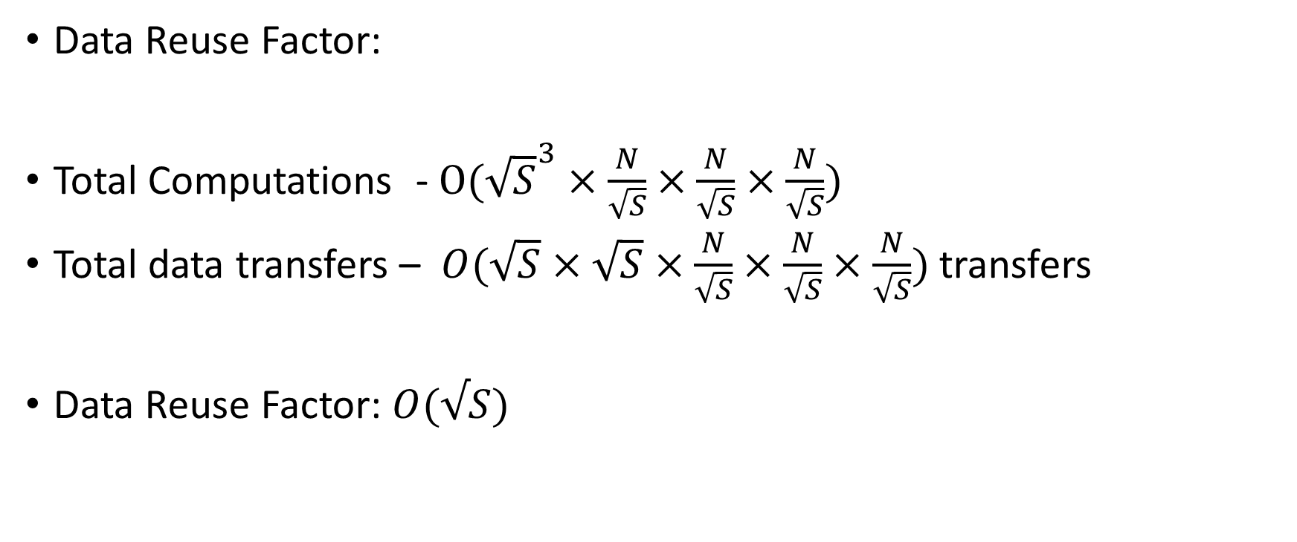
Block Matrix Multiplication
Data Reuse Factor:
Total Computations -$O({\sqrt{S}}^{3}×\frac{N}{\sqrt{S}}×\frac{N}{\sqrt{S}}×\frac{N}{\sqrt{S}})$
Total data transfers – $O(\sqrt{S}×\sqrt{S}×\frac{N}{\sqrt{S}}×\frac{N}{\sqrt{S}}×\frac{N}{\sqrt{S}})$ transfers
Data Reuse Factor: $O(√S)$

Slide 11
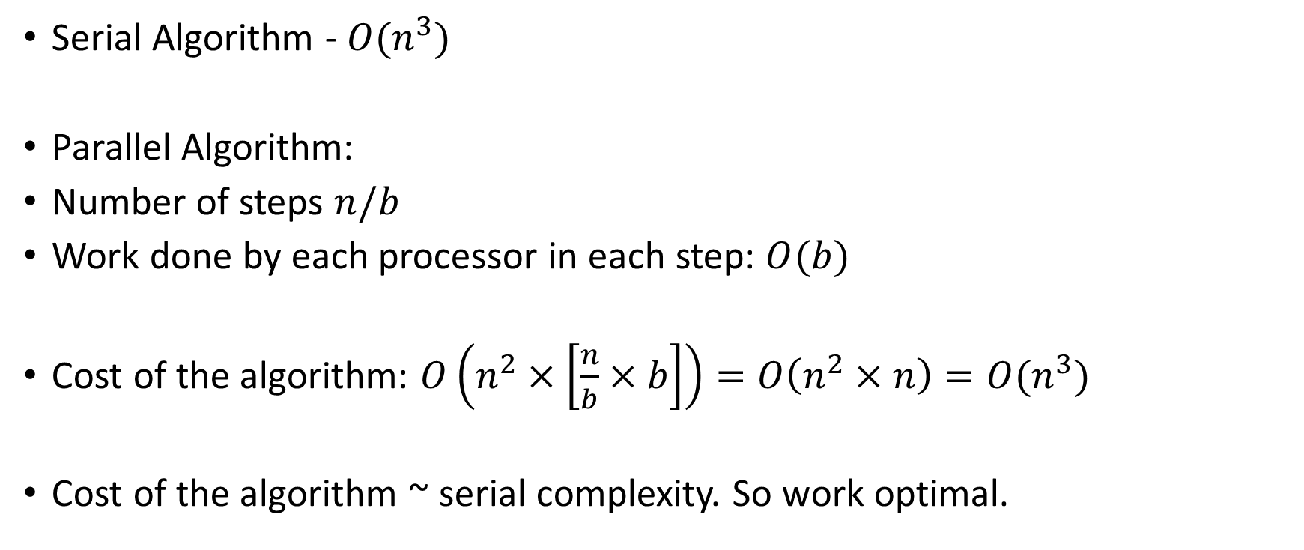
Blocked Matrix Multiplication
Serial Algorithm - $O(n^{3})$
Parallel Algorithm:
Number of steps $n/b$
Work done by each processor in each step: $O(b)$
Cost of the algorithm: $O\left(n^{2}×\left[\frac{n}{b}×b\right]\right)=O\left(n^{2}×n\right)=O(n^{3})$
Cost of the algorithm ~ serial complexity. So work optimal.

Slide 12
BLAS – Basic Linear Algebra Subprograms
A specification describing a set of low level routines for performing common linear algebra operations
Hardware vendors develop optimized versions for their platform,
While still conforming to the specification enabling portability

Slide 13
BLAS – Basic Linear Algebra Subprograms
Three levels of operations:
Level 1: Vector Operations such as dot products, vector addition, scaling, etc.
Level 2: Matrix Vector Operations such as matrix-vector multiplication or
Level 3: Matrix-Matrix Operations such as matrix multiplications, scaling, etc.

Slide 14
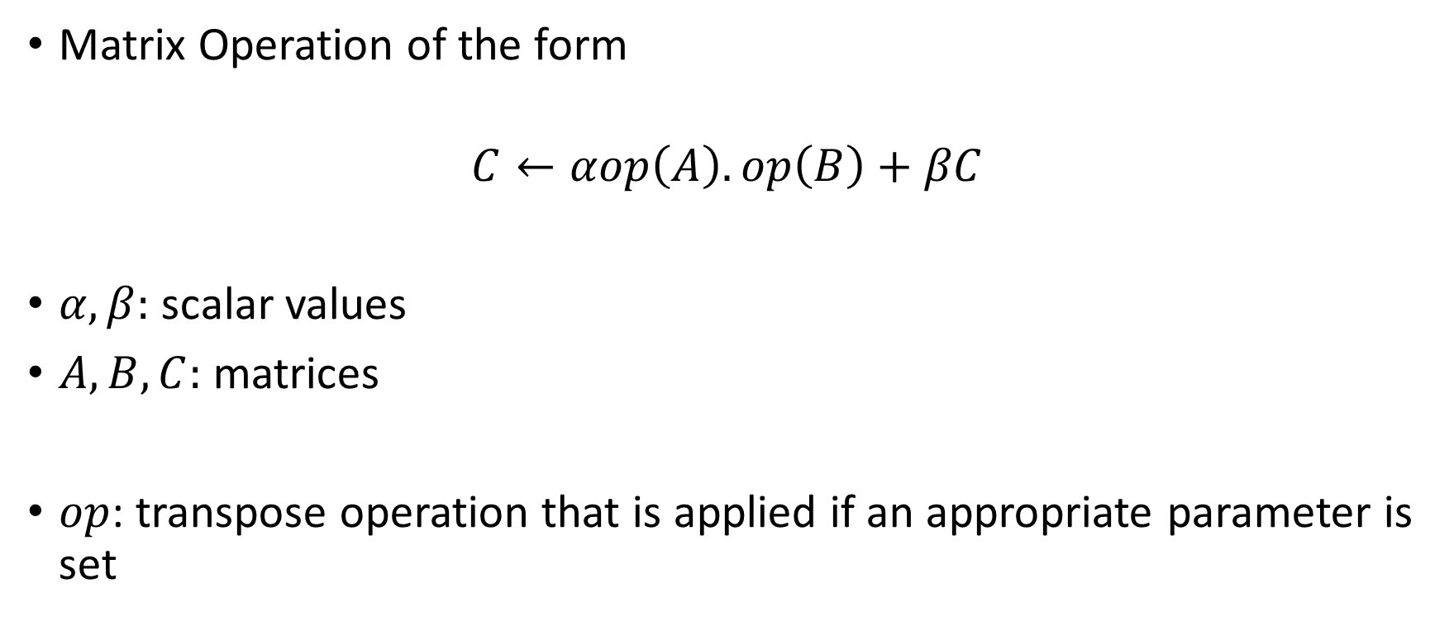
GEMM – Generalized Matrix Matrix Multiplication
Matrix Operation of the form
$$C←αop\left(A\right).op\left(B\right)+βC$$
$α, β:$ scalar values
$A, B, C:$ matrices
$op$: transpose operation that is applied if an appropriate parameter is set

Slide 15
GEMM – Generalized Matrix Matrix Multiplication
cublasStatus_t cublasSgemm(cublasHandle_t handle,
cublasOperation_t transa, cublasOperation_t transb,
int m, int n, int k,
const float *alpha,
const float *A, int lda,
const float *B, int ldb,
const float *beta,
float *C, int ldc)

Slide 16
GEMM – Generalized Matrix Matrix Multiplication
cublasStatus_t cublasSgemm(cublasHandle_t handle,
cublasOperation_t transa, cublasOperation_t transb,
int m, int n, int k,
const float *alpha,
const float *A, int lda,
const float *B, int ldb,
const float *beta,
float *C, int ldc)
Parameters that determine whether to transpose the matrix or not:
transa = CUBLAS_OP_N -> No transposition
transa = CUBLAS_OP_T -> Transpose
transa = CUBLAS_OP_H -> Hermitian Transpose

Slide 17
GEMM – Generalized Matrix Matrix Multiplication
cublasStatus_t cublasSgemm(cublasHandle_t handle,
cublasOperation_t transa, cublasOperation_t transb,
int m, int n, int k,
const float *alpha,
const float *A, int lda,
const float *B, int ldb,
const float *beta,
float *C, int ldc)
Dimensions of the matrices

Slide 18

GEMM – Generalized Matrix Matrix Multiplication
cublasStatus_t cublasSgemm(cublasHandle_t handle,
cublasOperation_t transa, cublasOperation_t transb,
int m, int n, int k,
const float *alpha,
const float *A, int lda,
const float *B, int ldb,
const float *beta,
float *C, int ldc)
Scalar Values $α, β$ in the equation

Slide 19
GEMM – Generalized Matrix Matrix Multiplication
cublasStatus_t cublasSgemm(cublasHandle_t handle,
cublasOperation_t transa, cublasOperation_t transb,
int m, int n, int k,
const float *alpha,
const float *A, int lda,
const float *B, int ldb,
const float *beta,
float *C, int ldc)
Pointers to the matrices (stored as a 1D array), leading dimension of the matrix
float A[12] = {1,2,3, 4,5,6, 7,8,9, 10,11,12};
Lda = 3; -> // 3x4 matrix

Slide 20
GEMM – Generalized Matrix Matrix Multiplication
Several variants exist – different data types, batched matrix multiplications, etc.
Ungraded HW Assignment: Try out an example on HPC on CPU or GPU
Find out what library to use for the CPU and the GPU
Find out how to properly setup the matrices and make the call
We will discuss the AMD library for BLAS when we study AMD HIP

Slide 21
Outline
Convolution as Matrix Multiplication – Motivation
Im2Col and Kn2Row Algorithms
Scalar Matrix Multiplication Algorithm

Slide 22
Im2col Algorithm
$$H$$
$$W$$
$$C_{in}$$
$$C_{in}$$
Convert all pixels under the window into column
$$C_{in}$$
$$k$$
$$k$$
$$C_{in}$$
$$C_{out}$$
Convert into a single Row
$$H$$
$$W$$

Slide 23























Im2col Algorithm
$$I_{1}$$
$$I_{2}$$
$$I_{3}$$
$$I_{4}$$
$$I_{5}$$
$$I_{6}$$
$$I_{7}$$
$$I_{8}$$
$$W_{1}$$
$$W_{2}$$
$$I_{1}$$
$$I_{9}$$
$$I_{10}$$
$$I_{11}$$
$$I_{12}$$
$$W_{3}$$
$$W_{4}$$
$$I_{2}$$
$$I_{13}$$
$$I_{14}$$
$$I_{15}$$
$$I_{16}$$
$$I_{5}$$
$$I_{6}$$
Single Input Single Output Channel

Slide 24




Im2col Algorithm
$$I_{1}$$
$$I_{2}$$
$$I_{3}$$
$$I_{4}$$
$$I_{5}$$
$$I_{6}$$
$$I_{7}$$
$$I_{8}$$
$$W_{1}$$
$$W_{2}$$
$$I_{1}$$
$$I_{2}$$
$$I_{9}$$
$$I_{10}$$
$$I_{11}$$
$$I_{12}$$
$$W_{3}$$
$$W_{4}$$
$$I_{2}$$
$$I_{3}$$
$$I_{13}$$
$$I_{14}$$
$$I_{15}$$
$$I_{16}$$
$$I_{5}$$
$$I_{6}$$
$$I_{6}$$
$$I_{7}$$
Single Input Single Output Channel

Slide 25




Im2col Algorithm
$$I_{1}$$
$$I_{2}$$
$$I_{3}$$
$$I_{4}$$
$$I_{5}$$
$$I_{6}$$
$$I_{7}$$
$$I_{8}$$
$$W_{1}$$
$$W_{2}$$
$$I_{1}$$
$$I_{2}$$
$$I_{3}$$
$$I_{9}$$
$$I_{10}$$
$$I_{11}$$
$$I_{12}$$
$$W_{3}$$
$$W_{4}$$
$$I_{2}$$
$$I_{3}$$
$$I_{4}$$
$$I_{13}$$
$$I_{14}$$
$$I_{15}$$
$$I_{16}$$
$$I_{5}$$
$$I_{6}$$
$$I_{7}$$
$$I_{6}$$
$$I_{7}$$
$$I_{8}$$
Single Input Single Output Channel

Slide 26
Im2col Algorithm
$$I_{1}$$
$$I_{2}$$
$$I_{3}$$
$$I_{4}$$
$$I_{5}$$
$$I_{6}$$
$$I_{7}$$
$$I_{8}$$
$$W_{1}$$
$$W_{2}$$
$$I_{1}$$
$$I_{2}$$
$$I_{3}$$
$$I_{9}$$
$$I_{10}$$
$$I_{11}$$
$$I_{12}$$
$$W_{3}$$
$$W_{4}$$
$$I_{2}$$
$$I_{3}$$
$$I_{4}$$
…
$$I_{13}$$
$$I_{14}$$
$$I_{15}$$
$$I_{16}$$
$$I_{5}$$
$$I_{6}$$
$$I_{7}$$
$$I_{6}$$
$$I_{7}$$
$$I_{8}$$
Single Input Single Output Channel

Slide 27



Im2col Algorithm
$$I_{1}$$
$$I_{2}$$
$$I_{3}$$
$$I_{4}$$
$$I_{5}$$
$$I_{6}$$
$$I_{7}$$
$$I_{8}$$
$$W_{1}$$
$$W_{2}$$
$$I_{1}$$
$$I_{2}$$
$$I_{3}$$
$$I_{9}$$
$$I_{10}$$
$$I_{11}$$
$$I_{12}$$
$$W_{3}$$
$$W_{4}$$
$$I_{2}$$
$$I_{3}$$
$$I_{4}$$
…
$$I_{13}$$
$$I_{14}$$
$$I_{15}$$
$$I_{16}$$
$$I_{5}$$
$$I_{6}$$
$$I_{7}$$
$$I_{6}$$
$$I_{7}$$
$$I_{8}$$
$$W_{1}$$
$$W_{2}$$
$$W_{3}$$
$$W_{4}$$
Single Input Single Output Channel

Slide 28
Im2col Algorithm
$$I_{1}$$
$$I_{2}$$
$$I_{3}$$
$$I_{4}$$
$$I_{5}$$
$$I_{6}$$
$$I_{7}$$
$$I_{8}$$
$$W_{1}$$
$$W_{2}$$
$$I_{1}$$
$$I_{2}$$
$$I_{3}$$
$$I_{9}$$
$$I_{10}$$
$$I_{11}$$
$$I_{12}$$
$$W_{3}$$
$$W_{4}$$
$$I_{2}$$
$$I_{3}$$
$$I_{4}$$
…
$$I_{13}$$
$$I_{14}$$
$$I_{15}$$
$$I_{16}$$
$$I_{5}$$
$$I_{6}$$
$$I_{7}$$
$$I_{6}$$
$$I_{7}$$
$$I_{8}$$
How many columns?
$$W_{1}$$
$$W_{2}$$
$$W_{3}$$
$$W_{4}$$
Single Input Single Output Channel

Slide 29
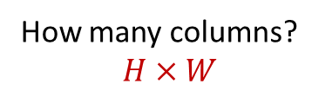
Im2col Algorithm
$$I_{1}$$
$$I_{2}$$
$$I_{3}$$
$$I_{4}$$
$$I_{5}$$
$$I_{6}$$
$$I_{7}$$
$$I_{8}$$
$$W_{1}$$
$$W_{2}$$
$$I_{1}$$
$$I_{2}$$
$$I_{3}$$
$$I_{9}$$
$$I_{10}$$
$$I_{11}$$
$$I_{12}$$
$$W_{3}$$
$$W_{4}$$
$$I_{2}$$
$$I_{3}$$
$$I_{4}$$
…
$$I_{13}$$
$$I_{14}$$
$$I_{15}$$
$$I_{16}$$
$$I_{5}$$
$$I_{6}$$
$$I_{7}$$
$$I_{6}$$
$$I_{7}$$
$$I_{8}$$
How many columns?
$$H×W$$
$$W_{1}$$
$$W_{2}$$
$$W_{3}$$
$$W_{4}$$
Single Input Single Output Channel

Slide 30
Im2col Algorithm
$$I_{1}$$
$$I_{2}$$
$$I_{3}$$
$$I_{4}$$
$$I_{5}$$
$$I_{6}$$
$$I_{7}$$
$$I_{8}$$
$$W_{1}$$
$$W_{2}$$
$$I_{1}$$
$$I_{2}$$
$$I_{3}$$
$$I_{9}$$
$$I_{10}$$
$$I_{11}$$
$$I_{12}$$
$$W_{3}$$
$$W_{4}$$
$$I_{2}$$
$$I_{3}$$
$$I_{4}$$
…
$$I_{13}$$
$$I_{14}$$
$$I_{15}$$
$$I_{16}$$
$$I_{5}$$
$$I_{6}$$
$$I_{7}$$
$$I_{6}$$
$$I_{7}$$
$$I_{8}$$
What is the inner dimension of the matrix multiplication?
$$W_{1}$$
$$W_{2}$$
$$W_{3}$$
$$W_{4}$$
Single Input Single Output Channel

Slide 31
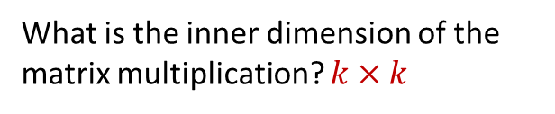
Im2col Algorithm
$$I_{1}$$
$$I_{2}$$
$$I_{3}$$
$$I_{4}$$
$$I_{5}$$
$$I_{6}$$
$$I_{7}$$
$$I_{8}$$
$$W_{1}$$
$$W_{2}$$
$$I_{1}$$
$$I_{2}$$
$$I_{3}$$
$$I_{9}$$
$$I_{10}$$
$$I_{11}$$
$$I_{12}$$
$$W_{3}$$
$$W_{4}$$
$$I_{2}$$
$$I_{3}$$
$$I_{4}$$
…
$$I_{13}$$
$$I_{14}$$
$$I_{15}$$
$$I_{16}$$
$$I_{5}$$
$$I_{6}$$
$$I_{7}$$
$$I_{6}$$
$$I_{7}$$
$$I_{8}$$
What is the inner dimension of the matrix multiplication? $k×k$
$$W_{1}$$
$$W_{2}$$
$$W_{3}$$
$$W_{4}$$
Single Input Single Output Channel

Slide 32








































































Im2col Algorithm
$$I_{1}$$
$$I_{2}$$
$$I_{3}$$
$$I_{2}$$
$$I_{3}$$
$$I_{4}$$
$$I_{1}$$
$$I_{2}$$
$$I_{3}$$
$$I_{4}$$
$$I_{1}$$
$$I_{2}$$
$$I_{3}$$
$$I_{4}$$
$$I_{5}$$
$$I_{6}$$
$$I_{7}$$
$$I_{5}$$
$$I_{5}$$
$$I_{6}$$
$$I_{7}$$
$$I_{8}$$
$$I_{6}$$
$$I_{7}$$
$$I_{8}$$
$$I_{6}$$
$$I_{7}$$
$$I_{8}$$
$$I_{9}$$
$$I_{10}$$
$$I_{11}$$
$$I_{12}$$
$$I_{9}$$
$$I_{10}$$
$$I_{11}$$
$$I_{12}$$
$$I_{1}$$
$$I_{2}$$
$$I_{3}$$
$$I_{13}$$
$$I_{14}$$
$$I_{15}$$
$$I_{16}$$
$$I_{13}$$
$$I_{14}$$
$$I_{15}$$
$$I_{16}$$
$$I_{2}$$
$$I_{3}$$
$$I_{4}$$
$$I_{5}$$
$$I_{6}$$
$$I_{7}$$
$$I_{6}$$
$$I_{7}$$
$$I_{8}$$
$$W_{1}$$
$$W_{2}$$
$$W_{1}$$
$$W_{2}$$
$$W_{1}$$
$$W_{2}$$
$$W_{3}$$
$$W_{4}$$
$$W_{1}$$
$$W_{2}$$
$$W_{3}$$
$$W_{4}$$
$$W_{3}$$
$$W_{4}$$
$$W_{3}$$
$$W_{4}$$
Multiple Input Single Output Channel

Slide 33
Im2col Algorithm
$$I_{1}$$
$$I_{2}$$
$$I_{3}$$
$$I_{2}$$
$$I_{3}$$
$$I_{4}$$
$$I_{1}$$
$$I_{2}$$
$$I_{3}$$
$$I_{4}$$
$$I_{1}$$
$$I_{2}$$
$$I_{3}$$
$$I_{4}$$
$$I_{5}$$
$$I_{6}$$
$$I_{7}$$
$$I_{5}$$
$$I_{5}$$
$$I_{6}$$
$$I_{7}$$
$$I_{8}$$
$$I_{6}$$
$$I_{7}$$
$$I_{8}$$
$$I_{6}$$
$$I_{7}$$
$$I_{8}$$
$$I_{9}$$
$$I_{10}$$
$$I_{11}$$
$$I_{12}$$
$$I_{9}$$
$$I_{10}$$
$$I_{11}$$
$$I_{12}$$
$$I_{1}$$
$$I_{2}$$
$$I_{3}$$
$$I_{13}$$
$$I_{14}$$
$$I_{15}$$
$$I_{16}$$
$$I_{13}$$
$$I_{14}$$
$$I_{15}$$
$$I_{16}$$
$$I_{2}$$
$$I_{3}$$
$$I_{4}$$
Notice: Input channels increase the row dimension of weight matrix and column dimension of the input feature matrix
$$I_{5}$$
$$I_{6}$$
$$I_{7}$$
$$I_{6}$$
$$I_{7}$$
$$I_{8}$$
$$W_{1}$$
$$W_{2}$$
$$W_{1}$$
$$W_{2}$$
$$W_{1}$$
$$W_{2}$$
$$W_{3}$$
$$W_{4}$$
$$W_{1}$$
$$W_{2}$$
$$W_{3}$$
$$W_{4}$$
$$W_{3}$$
$$W_{4}$$
$$W_{3}$$
$$W_{4}$$
Multiple Input Single Output Channel

Slide 34




























































Im2col Algorithm
$$I_{1}$$
$$I_{2}$$
$$I_{3}$$
$$I_{2}$$
$$I_{3}$$
$$I_{4}$$
$$I_{1}$$
$$I_{2}$$
$$I_{3}$$
$$I_{4}$$
$$I_{1}$$
$$I_{2}$$
$$I_{3}$$
$$I_{4}$$
$$I_{5}$$
$$I_{6}$$
$$I_{7}$$
$$I_{5}$$
$$I_{6}$$
$$I_{7}$$
$$I_{8}$$
$$I_{5}$$
$$I_{6}$$
$$I_{7}$$
$$I_{8}$$
$$I_{6}$$
$$I_{7}$$
$$I_{8}$$
$$k×k×C_{in}$$
$$I_{9}$$
$$I_{10}$$
$$I_{11}$$
$$I_{12}$$
$$I_{9}$$
$$I_{10}$$
$$I_{11}$$
$$I_{12}$$
$$I_{1}$$
$$I_{2}$$
$$I_{3}$$
$$I_{13}$$
$$I_{14}$$
$$I_{15}$$
$$I_{16}$$
$$I_{13}$$
$$I_{14}$$
$$I_{15}$$
$$I_{16}$$
$$I_{2}$$
$$I_{3}$$
$$I_{4}$$
$$I_{5}$$
$$I_{6}$$
$$I_{7}$$
$$k×k×C_{in}$$
$$I_{6}$$
$$I_{7}$$
$$I_{8}$$
$$W_{1}$$
$$W_{2}$$
$$W_{1}$$
$$W_{2}$$
$$H×W$$
$$W_{1}$$
$$W_{2}$$
$$W_{3}$$
$$W_{4}$$
$$W_{1}$$
$$W_{2}$$
$$W_{3}$$
$$W_{4}$$
$$W_{3}$$
$$W_{4}$$
$$W_{3}$$
$$W_{4}$$
$$C_{out}$$
$$W_{1}$$
$$W_{2}$$
$$W_{1}$$
$$W_{2}$$
$$W_{1}$$
$$W_{2}$$
$$W_{3}$$
$$W_{4}$$
$$W_{1}$$
$$W_{2}$$
$$W_{3}$$
$$W_{4}$$
$$W_{3}$$
$$W_{4}$$
$$W_{3}$$
$$W_{4}$$
Multiple Input Single Multiple Channel

Slide 35
Im2Col Algorithm
Input Matrix -$\left(k×k×C_{in}\right)×(H×W)$
$k×k$ increase in size
Filter Matrix - $\left(C_{out}\right)×(k×k×C_{in})$
No increase in size
Output Matrix - $C_{out}×(H×W)$
No increase in size

Slide 36
Implicit GEMM based Im2Col
In practice, the input matrix is not duplicated
Rather tiles/blocks are fetched into the shared cache of SMP by indexing appropriate addresses

Slide 37



























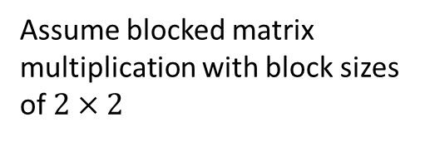

















Im2col Algorithm
$$I_{1}$$
$$I_{2}$$
$$I_{3}$$
$$I_{2}$$
$$I_{3}$$
$$I_{4}$$
$$I_{1}$$
$$I_{2}$$
$$I_{3}$$
$$I_{4}$$
$$I_{1}$$
$$I_{2}$$
$$I_{3}$$
$$I_{4}$$
$$I_{5}$$
$$I_{6}$$
$$I_{7}$$
$$I_{5}$$
$$I_{6}$$
$$I_{7}$$
$$I_{8}$$
$$I_{5}$$
$$I_{6}$$
$$I_{7}$$
$$I_{8}$$
$$I_{6}$$
$$I_{7}$$
$$I_{8}$$
Assume blocked matrix multiplication with block sizes of $2×2$
$$I_{9}$$
$$I_{10}$$
$$I_{12}$$
$$I_{9}$$
$$I_{10}$$
$$I_{12}$$
$$I_{1}$$
$$I_{2}$$
$$I_{3}$$
$$I_{11}$$
$$I_{11}$$
$$I_{13}$$
$$I_{14}$$
$$I_{15}$$
$$I_{16}$$
$$I_{13}$$
$$I_{14}$$
$$I_{15}$$
$$I_{16}$$
$$I_{2}$$
$$I_{3}$$
$$I_{4}$$
$$I_{5}$$
$$I_{6}$$
$$I_{7}$$
$$W_{1}$$
$$W_{2}$$
$$W_{1}$$
$$W_{2}$$
$$I_{6}$$
$$I_{7}$$
$$I_{8}$$
$$W_{3}$$
$$W_{4}$$
$$W_{3}$$
$$W_{4}$$
DRAM
$$W_{1}$$
$$W_{2}$$
$$W_{1}$$
$$W_{2}$$
$$W_{3}$$
$$W_{4}$$
$$W_{3}$$
$$W_{4}$$
$$W_{1}$$
$$W_{2}$$
$$W_{3}$$
$$W_{4}$$
$$W_{1}$$
$$W_{2}$$
$$W_{3}$$
$$W_{4}$$
$$W_{1}$$
$$W_{2}$$
$$W_{3}$$
$$W_{4}$$
$$W_{1}$$
$$W_{2}$$
$$W_{3}$$
$$W_{4}$$

Slide 38
Im2col Algorithm
Shared Memory/Cache
$$I_{1}$$
$$I_{2}$$
$$I_{3}$$
$$I_{2}$$
$$I_{3}$$
$$I_{4}$$
$$I_{1}$$
$$I_{2}$$
$$I_{3}$$
$$I_{4}$$
$$I_{1}$$
$$I_{2}$$
$$I_{3}$$
$$I_{4}$$
$$I_{5}$$
$$I_{6}$$
$$I_{7}$$
$$I_{5}$$
$$I_{6}$$
$$I_{7}$$
$$I_{8}$$
$$I_{5}$$
$$I_{6}$$
$$I_{7}$$
$$I_{8}$$
$$I_{6}$$
$$I_{7}$$
$$I_{8}$$
$$I_{9}$$
$$I_{10}$$
$$I_{12}$$
$$I_{9}$$
$$I_{10}$$
$$I_{12}$$
$$I_{1}$$
$$I_{2}$$
$$I_{3}$$
$$I_{11}$$
$$I_{11}$$
$$I_{13}$$
$$I_{14}$$
$$I_{15}$$
$$I_{16}$$
$$I_{13}$$
$$I_{14}$$
$$I_{15}$$
$$I_{16}$$
$$I_{2}$$
$$I_{3}$$
$$I_{4}$$
$$I_{5}$$
$$I_{6}$$
$$I_{7}$$
$$W_{1}$$
$$W_{2}$$
$$W_{1}$$
$$W_{2}$$
$$I_{6}$$
$$I_{7}$$
$$I_{8}$$
$$W_{3}$$
$$W_{4}$$
$$W_{3}$$
$$W_{4}$$
DRAM
Shared Memory/Cache
$$W_{1}$$
$$W_{2}$$
$$W_{1}$$
$$W_{2}$$
$$W_{3}$$
$$W_{4}$$
$$W_{3}$$
$$W_{4}$$
$$W_{1}$$
$$W_{2}$$
$$W_{3}$$
$$W_{4}$$
$$W_{1}$$
$$W_{2}$$
$$W_{3}$$
$$W_{4}$$
$$W_{1}$$
$$W_{2}$$
$$W_{3}$$
$$W_{4}$$
$$W_{1}$$
$$W_{2}$$
$$W_{3}$$
$$W_{4}$$

Slide 39
Im2col Algorithm
Shared Memory/Cache
$$I_{1}$$
$$I_{2}$$
$$I_{3}$$
$$I_{2}$$
$$I_{3}$$
$$I_{4}$$
$$I_{1}$$
$$I_{2}$$
$$I_{3}$$
$$I_{4}$$
$$I_{1}$$
$$I_{2}$$
$$I_{3}$$
$$I_{4}$$
$$I_{5}$$
$$I_{6}$$
$$I_{7}$$
$$I_{5}$$
$$I_{6}$$
$$I_{7}$$
$$I_{8}$$
$$I_{5}$$
$$I_{6}$$
$$I_{7}$$
$$I_{8}$$
$$I_{6}$$
$$I_{7}$$
$$I_{8}$$
$$I_{9}$$
$$I_{10}$$
$$I_{12}$$
$$I_{9}$$
$$I_{10}$$
$$I_{12}$$
$$I_{1}$$
$$I_{2}$$
$$I_{3}$$
$$I_{11}$$
$$I_{11}$$
$$I_{13}$$
$$I_{14}$$
$$I_{15}$$
$$I_{16}$$
$$I_{13}$$
$$I_{14}$$
$$I_{15}$$
$$I_{16}$$
$$I_{2}$$
$$I_{3}$$
$$I_{4}$$
$$I_{5}$$
$$I_{6}$$
$$I_{7}$$
$$W_{1}$$
$$W_{2}$$
$$W_{1}$$
$$W_{2}$$
$$I_{6}$$
$$I_{7}$$
$$I_{8}$$
$$W_{3}$$
$$W_{4}$$
$$W_{3}$$
$$W_{4}$$
DRAM
Shared Memory/Cache
$$W_{1}$$
$$W_{2}$$
$$W_{1}$$
$$W_{2}$$
$$W_{3}$$
$$W_{4}$$
$$W_{3}$$
$$W_{4}$$
$$W_{1}$$
$$W_{2}$$
$$W_{3}$$
$$W_{4}$$
$$W_{1}$$
$$W_{2}$$
$$W_{3}$$
$$W_{4}$$
$$W_{1}$$
$$W_{2}$$
$$W_{3}$$
$$W_{4}$$
$$W_{1}$$
$$W_{2}$$
$$W_{3}$$
$$W_{4}$$

Slide 40
Im2col Algorithm
Shared Memory/Cache
$$I_{1}$$
$$I_{2}$$
$$I_{3}$$
$$I_{2}$$
$$I_{3}$$
$$I_{4}$$
$$I_{1}$$
$$I_{2}$$
$$I_{3}$$
$$I_{4}$$
$$I_{1}$$
$$I_{2}$$
$$I_{3}$$
$$I_{4}$$
$$I_{5}$$
$$I_{6}$$
$$I_{7}$$
$$I_{5}$$
$$I_{6}$$
$$I_{7}$$
$$I_{8}$$
$$I_{5}$$
$$I_{6}$$
$$I_{7}$$
$$I_{8}$$
$$I_{6}$$
$$I_{7}$$
$$I_{8}$$
$$I_{9}$$
$$I_{10}$$
$$I_{12}$$
$$I_{9}$$
$$I_{10}$$
$$I_{12}$$
$$I_{1}$$
$$I_{2}$$
$$I_{3}$$
$$I_{11}$$
$$I_{11}$$
$$I_{13}$$
$$I_{14}$$
$$I_{15}$$
$$I_{16}$$
$$I_{13}$$
$$I_{14}$$
$$I_{15}$$
$$I_{16}$$
$$I_{2}$$
$$I_{3}$$
$$I_{4}$$
$$I_{5}$$
$$I_{6}$$
$$I_{7}$$
$$W_{1}$$
$$W_{2}$$
$$W_{1}$$
$$W_{2}$$
$$I_{6}$$
$$I_{7}$$
$$I_{8}$$
$$W_{3}$$
$$W_{4}$$
$$W_{3}$$
$$W_{4}$$
DRAM
Shared Memory/Cache
$$W_{1}$$
$$W_{2}$$
$$W_{1}$$
$$W_{2}$$
$$W_{3}$$
$$W_{4}$$
$$W_{3}$$
$$W_{4}$$
$$W_{1}$$
$$W_{2}$$
$$W_{3}$$
$$W_{4}$$
$$W_{1}$$
$$W_{2}$$
$$W_{3}$$
$$W_{4}$$
$$W_{1}$$
$$W_{2}$$
$$W_{3}$$
$$W_{4}$$
$$W_{1}$$
$$W_{2}$$
$$W_{3}$$
$$W_{4}$$

Slide 41
Im2col Algorithm
Shared Memory/Cache
$$I_{1}$$
$$I_{2}$$
$$I_{3}$$
$$I_{2}$$
$$I_{3}$$
$$I_{4}$$
$$I_{1}$$
$$I_{2}$$
$$I_{3}$$
$$I_{4}$$
$$I_{1}$$
$$I_{2}$$
$$I_{3}$$
$$I_{4}$$
$$I_{5}$$
$$I_{6}$$
$$I_{7}$$
$$I_{5}$$
$$I_{6}$$
$$I_{7}$$
$$I_{8}$$
$$I_{5}$$
$$I_{6}$$
$$I_{7}$$
$$I_{8}$$
$$I_{6}$$
$$I_{7}$$
$$I_{8}$$
$$I_{9}$$
$$I_{10}$$
$$I_{12}$$
$$I_{9}$$
$$I_{10}$$
$$I_{12}$$
$$I_{1}$$
$$I_{2}$$
$$I_{3}$$
$$I_{11}$$
$$I_{11}$$
$$I_{13}$$
$$I_{14}$$
$$I_{15}$$
$$I_{16}$$
$$I_{13}$$
$$I_{14}$$
$$I_{15}$$
$$I_{16}$$
$$I_{2}$$
$$I_{3}$$
$$I_{4}$$
$$I_{5}$$
$$I_{6}$$
$$I_{7}$$
$$W_{1}$$
$$W_{2}$$
$$W_{1}$$
$$W_{2}$$
$$I_{6}$$
$$I_{7}$$
$$I_{8}$$
$$W_{3}$$
$$W_{4}$$
$$W_{3}$$
$$W_{4}$$
DRAM
Shared Memory/Cache
$$W_{1}$$
$$W_{2}$$
$$W_{1}$$
$$W_{2}$$
$$W_{3}$$
$$W_{4}$$
$$W_{3}$$
$$W_{4}$$
$$W_{1}$$
$$W_{2}$$
$$W_{3}$$
$$W_{4}$$
$$W_{1}$$
$$W_{2}$$
$$W_{3}$$
$$W_{4}$$
$$W_{1}$$
$$W_{2}$$
$$W_{3}$$
$$W_{4}$$
$$W_{1}$$
$$W_{2}$$
$$W_{3}$$
$$W_{4}$$

Slide 42














Kn2Row Algorithm
$$H$$
$$H$$
$$W$$
$$C_{in}$$
$$k$$
$$W$$
$$C_{in}$$
$$k$$
$$C_{in}$$
$$k$$
$$k^{2}$$
$$k$$
$$C_{in}$$
+
+
$$C_{out}$$

Slide 43

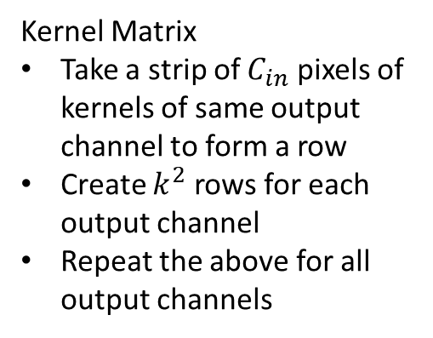










Kn2Row Algorithm
Kernel Matrix
Take a strip of $C_{in}$ pixels of kernels of same output channel to form a row
Create $k^{2}$ rows for each output channel
Repeat the above for all output channels
$$H$$
$$W$$
$$C_{in}$$
$$C_{in}$$
$$C_{in}$$
$$k$$
$$k$$
$$C_{in}$$
$$C_{out}$$
$$H$$
$$W$$

Slide 44
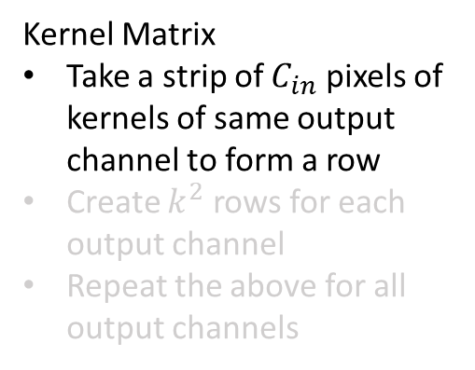

Kn2Row Algorithm
Kernel Matrix
Take a strip of $C_{in}$ pixels of kernels of same output channel to form a row
Create $k^{2}$ rows for each output channel
Repeat the above for all output channels
$$H$$
$$W$$
$$C_{in}$$
$$C_{in}$$
$$C_{in}$$
$$C_{in}$$
$$k$$
$$k$$
$$C_{in}$$
$$C_{out}$$
$$H$$
$$W$$

Slide 45
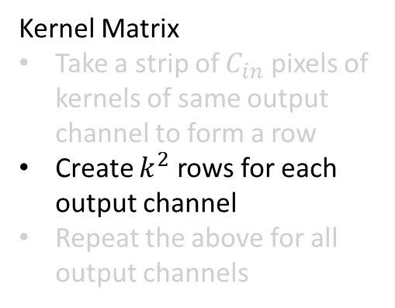


Kn2Row Algorithm
Kernel Matrix
Take a strip of $C_{in}$ pixels of kernels of same output channel to form a row
Create $k^{2}$ rows for each output channel
Repeat the above for all output channels
$$H$$
$$W$$
$$C_{in}$$
$$C_{in}$$
$$C_{in}$$
$$C_{in}$$
$$k$$
$$k$$
$$C_{in}$$
$$k^{2}$$
$$C_{out}$$
$$H$$
$$W$$

Slide 46
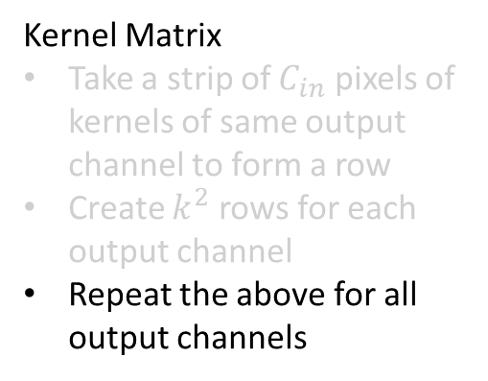




Kn2Row Algorithm
Kernel Matrix
Take a strip of $C_{in}$ pixels of kernels of same output channel to form a row
Create $k^{2}$ rows for each output channel
Repeat the above for all output channels
$$H$$
$$W$$
$$C_{in}$$
$$C_{in}$$
$$C_{in}$$
$$C_{in}$$
$$k$$
$$k^{2}$$
$$k$$
$$C_{in}$$
$$C_{out}$$
…
$$C_{out}$$
$$H$$
$$W$$
$$k^{2}$$

Slide 47
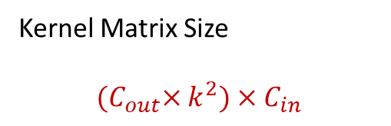
Kn2Row Algorithm
Kernel Matrix Size
$${(C}_{out}×k^{2})×C_{in}$$
$$H$$
$$W$$
$$C_{in}$$
$$C_{in}$$
$$C_{in}$$
$$C_{in}$$
$$k$$
$$k^{2}$$
$$k$$
$$C_{in}$$
$$C_{out}$$
…
$$C_{out}$$
$$H$$
$$W$$
$$k^{2}$$

Slide 48
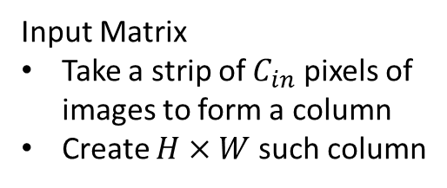
Kn2Row Algorithm
Input Matrix
Take a strip of $C_{in}$ pixels of images to form a column
Create $H×W$ such column
$$H$$
$$W$$
$$C_{in}$$
$$C_{in}$$
$$C_{in}$$
$$k$$
$$k$$
$$C_{in}$$
$$C_{out}$$
$$H$$
$$W$$

Slide 49
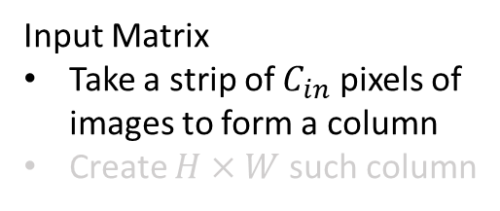

Kn2Row Algorithm
Input Matrix
Take a strip of $C_{in}$ pixels of images to form a column
Create $H×W$ such column
$$H$$
$$W$$
$$C_{in}$$
$$C_{in}$$
$$C_{in}$$
$$k$$
$$C_{in}$$
$$k$$
$$C_{in}$$
$$C_{out}$$
$$H$$
$$W$$

Slide 50

Kn2Row Algorithm
Input Matrix
Take a strip of $C_{in}$ pixels of images to form a column
Create $H×W$ such column
$$H$$
$$W$$
$$C_{in}$$
$$C_{in}$$
$$C_{in}$$
$$k$$
$$C_{in}$$
…
$$k$$
$$C_{in}$$
$$C_{out}$$
$$H$$
$$H×W$$
$$W$$

Slide 51







Kn2Row Algorithm
$$C_{in}$$
$$k^{2}$$
…
X
$$C_{in}$$
…
$$C_{out}$$
$$k^{2}$$
…
$$H×W$$
$$k^{2}$$

Slide 52




Kn2Row Algorithm
$$C_{in}$$
$$k^{2}$$
…
$$k^{2}$$
…
X
$$C_{in}$$
…
=
…
…
$$C_{out}$$
$$C_{out}$$
$$k^{2}$$
…
…
$$H×W$$
$$k^{2}$$
$$k^{2}$$
$$H×W$$

Slide 53
Kn2Row Algorithm
$$C_{in}$$
$$k^{2}$$
+
+
+
…
+
+
$$k^{2}$$
…
X
$$C_{in}$$
…
=
…
…
$$C_{out}$$
$$C_{out}$$
$$k^{2}$$
…
+
+
+
…
+
+
$$H×W$$
$$k^{2}$$
$$k^{2}$$
$$H×W$$
*The sums above are shift-add,

Slide 54

Kn2Row Algorithm
$$C_{in}$$
$$k^{2}$$
…
X
$$C_{in}$$
…
=
…
…
$$C_{out}$$
$$C_{out}$$
$$k^{2}$$
…
$$H×W$$
$$H×W$$
$$k^{2}$$

Slide 55

Kn2Row Algorithm
Input Matrix -$\left(C_{in}\right)×(H×W)$
Filter Matrix - $\left(C_{out}×k^{2}\right)×(C_{in})$
No increase in size
Output Matrix -$\left(H×W\right)×(C_{out}×k^{2})$
$k×k$ increase in size

Slide 56
Outline
Convolution as Matrix Multiplication – Motivation
Im2Col and Kn2Row Algorithms
Scalar Matrix Multiplication Algorithm

Slide 57
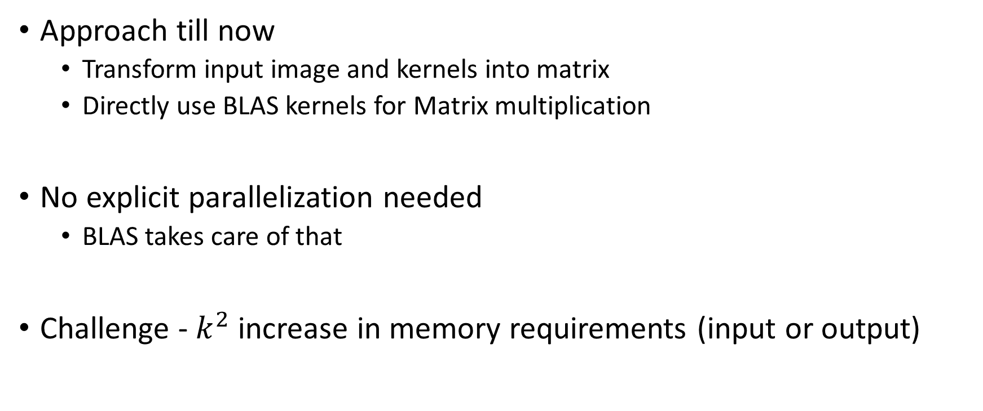
Scalar Matrix Multiplication
Approach till now
Transform input image and kernels into matrix
Directly use BLAS kernels for Matrix multiplication
No explicit parallelization needed
BLAS takes care of that
Challenge - $k^{2}$ increase in memory requirements (input or output)

Slide 58
Scalar Matrix Multiplication
Key Idea: Output image is a linear combination of “portions” of input image with weights as kernels
Avoid matrix multiplication, perform scaling and matrix addition operations
Scaling: Multiply entire vector/matrix with a single scalar value

Slide 59
















Scalar Matrix Multiplication
$$I_{1}$$
$$I_{2}$$
$$I_{3}$$
$$I_{4}$$
$$O_{1}$$
$$O_{2}$$
$$O_{3}$$
$$O_{4}$$
$$I_{5}$$
$$I_{6}$$
$$I_{7}$$
$$I_{8}$$
$$W_{1}$$
$$W_{2}$$
$$O_{5}$$
$$O_{6}$$
$$O_{7}$$
$$O_{8}$$
$$I_{9}$$
$$I_{10}$$
$$I_{11}$$
$$I_{12}$$
$$W_{3}$$
$$W_{4}$$
$$O_{9}$$
$$O_{10}$$
$$O_{11}$$
$$O_{12}$$
$$I_{13}$$
$$I_{14}$$
$$I_{15}$$
$$I_{16}$$
$$O_{13}$$
$$O_{14}$$
$$O_{15}$$
$$O_{16}$$
Single Input, Single Output Channel

Slide 60









Scalar Matrix Multiplication
$$I_{1}$$
$$I_{2}$$
$$I_{3}$$
$$I_{4}$$
$$O_{1}$$
$$O_{2}$$
$$O_{3}$$
$$O_{4}$$
$$0$$
$$0$$
$$I_{5}$$
$$I_{6}$$
$$I_{7}$$
$$I_{8}$$
$$W_{1}$$
$$W_{2}$$
$$O_{5}$$
$$O_{6}$$
$$O_{7}$$
$$O_{8}$$
$$I_{9}$$
$$I_{10}$$
$$I_{11}$$
$$I_{12}$$
$$W_{3}$$
$$W_{4}$$
$$O_{9}$$
$$O_{10}$$
$$O_{11}$$
$$O_{12}$$
$$0$$
$$0$$
$$I_{13}$$
$$I_{14}$$
$$I_{15}$$
$$I_{16}$$
$$O_{13}$$
$$O_{14}$$
$$O_{15}$$
$$O_{16}$$
$$0$$
$$0$$
$$0$$
$$0$$
$$0$$
Single Input, Single Output Channel

Slide 61

















Scalar Matrix Multiplication
$$I_{1}$$
$$I_{2}$$
$$I_{3}$$
$$I_{4}$$
$$O_{1}$$
$$O_{2}$$
$$O_{3}$$
$$O_{4}$$
$$I_{5}$$
$$I_{6}$$
$$I_{7}$$
$$I_{8}$$
$$W_{1}$$
$$W_{2}$$
$$O_{5}$$
$$O_{6}$$
$$O_{7}$$
$$O_{8}$$
$$I_{9}$$
$$I_{10}$$
$$I_{11}$$
$$I_{12}$$
$$W_{3}$$
$$W_{4}$$
$$O_{9}$$
$$O_{10}$$
$$O_{11}$$
$$O_{12}$$
$$I_{13}$$
$$I_{14}$$
$$I_{15}$$
$$I_{16}$$
$$O_{13}$$
$$O_{14}$$
$$O_{15}$$
$$O_{16}$$

Slide 62










Scalar Matrix Multiplication
$$I_{1}$$
$$I_{2}$$
$$I_{3}$$
$$I_{4}$$
$$O_{1}$$
$$O_{2}$$
$$O_{3}$$
$$O_{4}$$
$$I_{5}$$
$$I_{6}$$
$$I_{7}$$
$$I_{8}$$
$$W_{1}$$
$$W_{2}$$
$$O_{5}$$
$$O_{6}$$
$$O_{7}$$
$$O_{8}$$
$$I_{9}$$
$$I_{10}$$
$$I_{11}$$
$$I_{12}$$
$$W_{3}$$
$$W_{4}$$
$$O_{9}$$
$$O_{10}$$
$$O_{11}$$
$$O_{12}$$
$$I_{13}$$
$$I_{14}$$
$$I_{15}$$
$$I_{16}$$
$$O_{13}$$
$$O_{14}$$
$$O_{15}$$
$$O_{16}$$

Slide 63








Scalar Matrix Multiplication
$$I_{1}$$
$$I_{2}$$
$$I_{3}$$
$$I_{4}$$
$$O_{1}$$
$$O_{2}$$
$$O_{3}$$
$$O_{4}$$
$$I_{5}$$
$$I_{6}$$
$$I_{7}$$
$$I_{8}$$
$$W_{1}$$
$$W_{2}$$
$$O_{5}$$
$$O_{6}$$
$$O_{7}$$
$$O_{8}$$
$$I_{9}$$
$$I_{10}$$
$$I_{11}$$
$$I_{12}$$
$$W_{3}$$
$$W_{4}$$
$$O_{9}$$
$$O_{10}$$
$$O_{11}$$
$$O_{12}$$
$$I_{13}$$
$$I_{14}$$
$$I_{15}$$
$$I_{16}$$
$$O_{13}$$
$$O_{14}$$
$$O_{15}$$
$$O_{16}$$

Slide 64


Scalar Matrix Multiplication
$$I_{1}$$
$$I_{2}$$
$$I_{3}$$
$$I_{4}$$
$$O_{1}$$
$$O_{2}$$
$$O_{3}$$
$$O_{4}$$
$$I_{5}$$
$$I_{6}$$
$$I_{7}$$
$$I_{8}$$
$$W_{1}$$
$$W_{2}$$
$$O_{5}$$
$$O_{6}$$
$$O_{7}$$
$$O_{8}$$
$$I_{9}$$
$$I_{10}$$
$$I_{11}$$
$$I_{12}$$
$$W_{3}$$
$$W_{4}$$
$$O_{9}$$
$$O_{10}$$
$$O_{11}$$
$$O_{12}$$
$$I_{13}$$
$$I_{14}$$
$$I_{15}$$
$$I_{16}$$
$$O_{13}$$
$$O_{14}$$
$$O_{15}$$
$$O_{16}$$

Slide 65




Scalar Matrix Multiplication
Observe: weights along the same column operate on similar inputs
$$I_{1}$$
$$I_{2}$$
$$I_{3}$$
$$I_{4}$$
$$I_{5}$$
$$I_{6}$$
$$I_{7}$$
$$I_{8}$$
$$W_{1}$$
$$W_{2}$$
$$I_{9}$$
$$I_{10}$$
$$I_{11}$$
$$I_{12}$$
$$W_{3}$$
$$W_{4}$$
$$I_{13}$$
$$I_{14}$$
$$I_{15}$$
$$I_{16}$$
$$I_{1}$$
$$I_{2}$$
$$I_{3}$$
$$I_{4}$$
$$I_{5}$$
$$I_{6}$$
$$I_{7}$$
$$I_{8}$$
$$W_{1}$$
$$W_{2}$$
$$I_{9}$$
$$I_{10}$$
$$I_{11}$$
$$I_{12}$$
$$W_{3}$$
$$W_{4}$$
$$I_{13}$$
$$I_{14}$$
$$I_{15}$$
$$I_{16}$$

Slide 66






Scalar Matrix Multiplication
Observe: weights along the same column operate on similar inputs
$$I_{1}$$
$$I_{2}$$
$$I_{3}$$
$$I_{4}$$
$$I_{5}$$
$$I_{6}$$
$$I_{7}$$
$$I_{8}$$
$$W_{1}$$
$$W_{2}$$
$$I_{9}$$
$$I_{10}$$
$$I_{11}$$
$$I_{12}$$
$$W_{3}$$
$$W_{4}$$
$$I_{13}$$
$$I_{14}$$
$$I_{15}$$
$$I_{16}$$
$$I_{1}$$
$$I_{2}$$
$$I_{3}$$
$$I_{4}$$
$$I_{5}$$
$$I_{6}$$
$$I_{7}$$
$$I_{8}$$
$$W_{1}$$
$$W_{2}$$
$$I_{9}$$
$$I_{10}$$
$$I_{11}$$
$$I_{12}$$
$$W_{3}$$
$$W_{4}$$
$$I_{13}$$
$$I_{14}$$
$$I_{15}$$
$$I_{16}$$

Slide 67
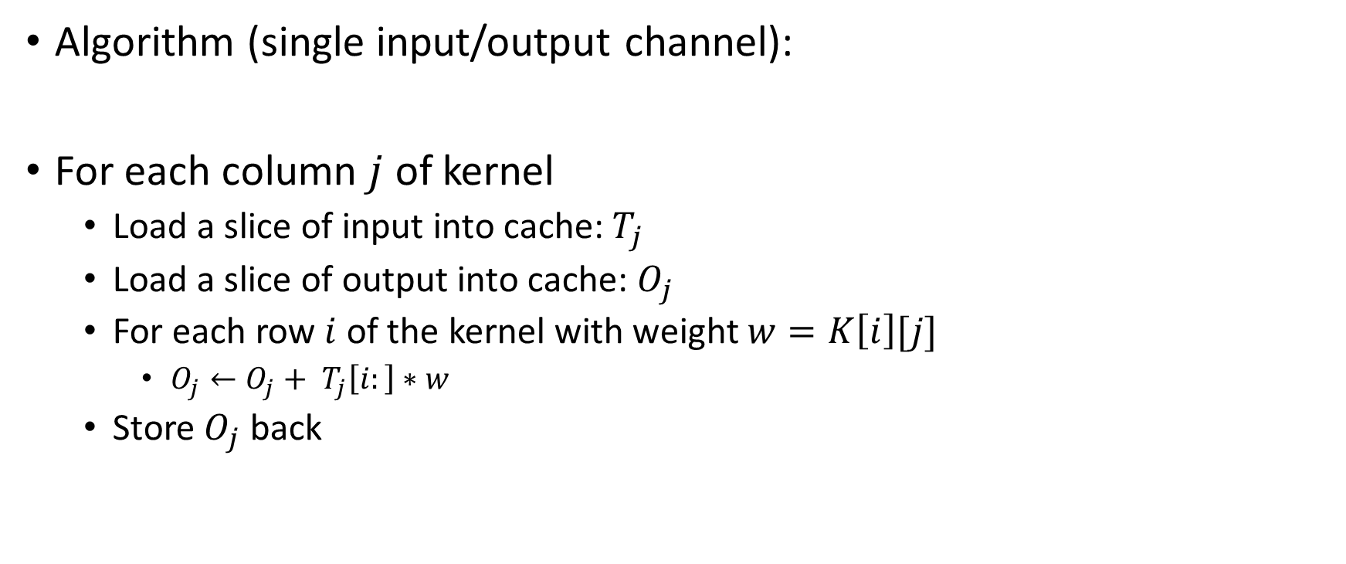
Scalar Matrix Multiplication
Algorithm (single input/output channel):
For each column $j$ of kernel
Load a slice of input into cache: $T_{j}$
Load a slice of output into cache: $O_{j}$
For each row $i$ of the kernel with weight $w=K\left[i\right][j]$
$O_{j}←O_{j}+ T_{j}\left[i:\right]∗w$
Store $O_{j}$ back

Slide 68

Scalar Matrix Multiplication
For each column $j$
$$I_{1}$$
$$I_{2}$$
$$I_{3}$$
$$I_{4}$$
$$I_{5}$$
$$I_{6}$$
$$I_{7}$$
$$I_{8}$$
$$W_{1}$$
$$W_{2}$$
$$I_{9}$$
$$I_{10}$$
$$I_{11}$$
$$I_{12}$$
$$W_{3}$$
$$W_{4}$$
$$I_{13}$$
$$I_{14}$$
$$I_{15}$$
$$I_{16}$$

Slide 69
Scalar Matrix Multiplication
Load a slice of input: $T_{j}$
$$I_{1}$$
$$I_{2}$$
$$I_{3}$$
$$I_{4}$$
$$I_{5}$$
$$I_{6}$$
$$I_{7}$$
$$I_{8}$$
$$W_{1}$$
$$W_{2}$$
$$I_{9}$$
$$I_{10}$$
$$I_{11}$$
$$I_{12}$$
$$W_{3}$$
$$W_{4}$$
$$I_{13}$$
$$I_{14}$$
$$I_{15}$$
$$I_{16}$$

Slide 70
















Scalar Matrix Multiplication
Load a slice of output: $O_{j}$
$$I_{1}$$
$$I_{2}$$
$$I_{3}$$
$$I_{4}$$
$$O_{1}$$
$$O_{2}$$
$$O_{3}$$
$$O_{4}$$
$$I_{5}$$
$$I_{6}$$
$$I_{7}$$
$$I_{8}$$
$$W_{1}$$
$$W_{2}$$
$$O_{5}$$
$$O_{6}$$
$$O_{7}$$
$$O_{8}$$
$$I_{9}$$
$$I_{10}$$
$$I_{11}$$
$$I_{12}$$
$$W_{3}$$
$$W_{4}$$
$$O_{9}$$
$$O_{10}$$
$$O_{11}$$
$$O_{12}$$
$$I_{13}$$
$$I_{14}$$
$$I_{15}$$
$$I_{16}$$
$$O_{13}$$
$$O_{14}$$
$$O_{15}$$
$$O_{16}$$

Slide 71

















Scalar Matrix Multiplication
For each row $i$ of the kernel with weight $w=K\left[i\right][j]$
$O_{j}←O_{j}+ T_{j}\left[i:\right]∗w$
$$I_{1}$$
$$I_{2}$$
$$I_{3}$$
$$I_{4}$$
$$O_{1}$$
$$O_{2}$$
$$O_{3}$$
$$O_{4}$$
$$I_{5}$$
$$I_{6}$$
$$I_{7}$$
$$I_{8}$$
$$W_{1}$$
$$W_{2}$$
$$O_{5}$$
$$O_{6}$$
$$O_{7}$$
$$O_{8}$$
$$I_{9}$$
$$I_{10}$$
$$I_{11}$$
$$I_{12}$$
$$W_{3}$$
$$W_{4}$$
$$O_{9}$$
$$O_{10}$$
$$O_{11}$$
$$O_{12}$$
$$I_{13}$$
$$I_{14}$$
$$I_{15}$$
$$I_{16}$$
$$O_{13}$$
$$O_{14}$$
$$O_{15}$$
$$O_{16}$$

Slide 72





Scalar Matrix Multiplication
For each row $i$ of the kernel with weight $w=K\left[i\right][j]$
$O_{j}←O_{j}+ T_{j}\left[i:\right]∗w$
$$I_{1}$$
$$I_{2}$$
$$I_{3}$$
$$I_{4}$$
$$O_{1}$$
$$O_{2}$$
$$O_{3}$$
$$O_{4}$$
$$I_{5}$$
$$I_{6}$$
$$I_{7}$$
$$I_{8}$$
$$W_{1}$$
$$W_{2}$$
$$O_{5}$$
$$O_{6}$$
$$O_{7}$$
$$O_{8}$$
$$I_{9}$$
$$I_{10}$$
$$I_{11}$$
$$I_{12}$$
$$W_{3}$$
$$W_{4}$$
$$O_{9}$$
$$O_{10}$$
$$O_{11}$$
$$O_{12}$$
$$I_{13}$$
$$I_{14}$$
$$I_{15}$$
$$I_{16}$$
$$O_{13}$$
$$O_{14}$$
$$O_{15}$$
$$O_{16}$$

Slide 73
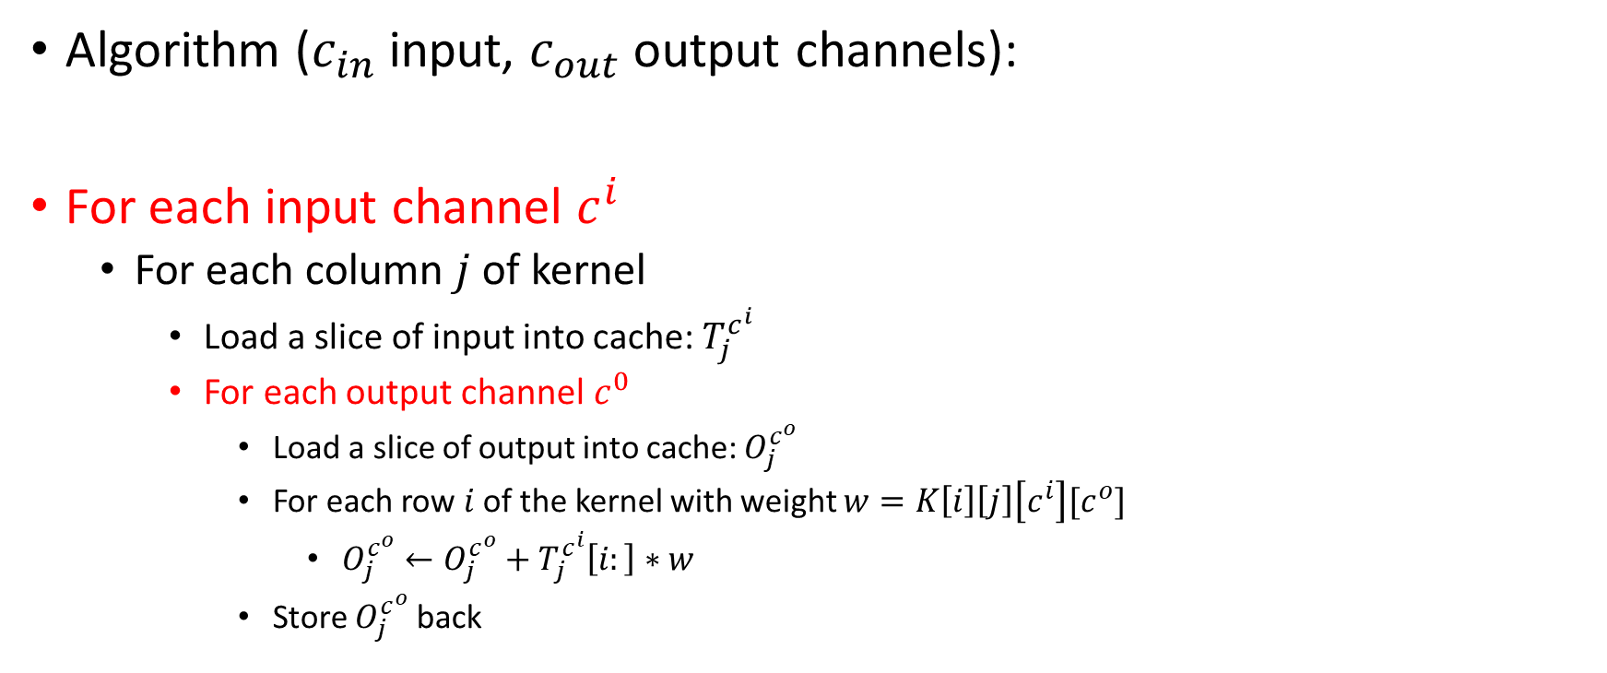
Scalar Matrix Multiplication
Algorithm ($c_{in}$ input, $c_{out}$output channels):
For each input channel $c^{i}$
For each column $j$ of kernel
Load a slice of input into cache: $T_{j}^{c^{i}}$
For each output channel $c^{0}$
Load a slice of output into cache: $O_{j}^{c^{o}}$
For each row $i$ of the kernel with weight $w=K\left[i\right]\left[j\right]\left[c^{i}\right][c^{o}]$
$O_{j}^{c^{o}}←O_{j}^{c^{o}}+T_{j}^{c^{i}}\left[i:\right]∗w$
Store $O_{j}^{c^{o}}$ back

Slide 74




































Scalar Matrix Multiplication
Select a slice of output: $O_{j}$
$$O_{1}$$
$$O_{2}$$
$$O_{3}$$
$$O_{4}$$
$$W_{1}$$
$$W_{2}$$
$$O_{5}$$
$$O_{6}$$
$$O_{7}$$
$$O_{8}$$
$$W_{3}$$
$$W_{4}$$
$$O_{9}$$
$$O_{10}$$
$$O_{11}$$
$$O_{12}$$
Output Channel 0
$$O_{13}$$
$$O_{14}$$
$$O_{15}$$
$$O_{16}$$
…
$$I_{1}$$
$$I_{2}$$
$$I_{3}$$
$$I_{4}$$
$$I_{5}$$
$$I_{6}$$
$$I_{7}$$
$$I_{8}$$
$$O_{1}$$
$$O_{2}$$
$$O_{3}$$
$$O_{4}$$
$$I_{9}$$
$$I_{10}$$
$$I_{11}$$
$$I_{12}$$
$$O_{5}$$
$$O_{6}$$
$$O_{7}$$
$$O_{8}$$
$$W_{1}$$
$$W_{2}$$
$$I_{13}$$
$$I_{14}$$
$$I_{15}$$
$$I_{16}$$
Output Channel $C_{o}$
$$W_{3}$$
$$W_{4}$$
$$O_{9}$$
$$O_{10}$$
$$O_{11}$$
$$O_{12}$$
Input Channel $C^{i}$
$$O_{13}$$
$$O_{14}$$
$$O_{15}$$
$$O_{16}$$

Slide 75
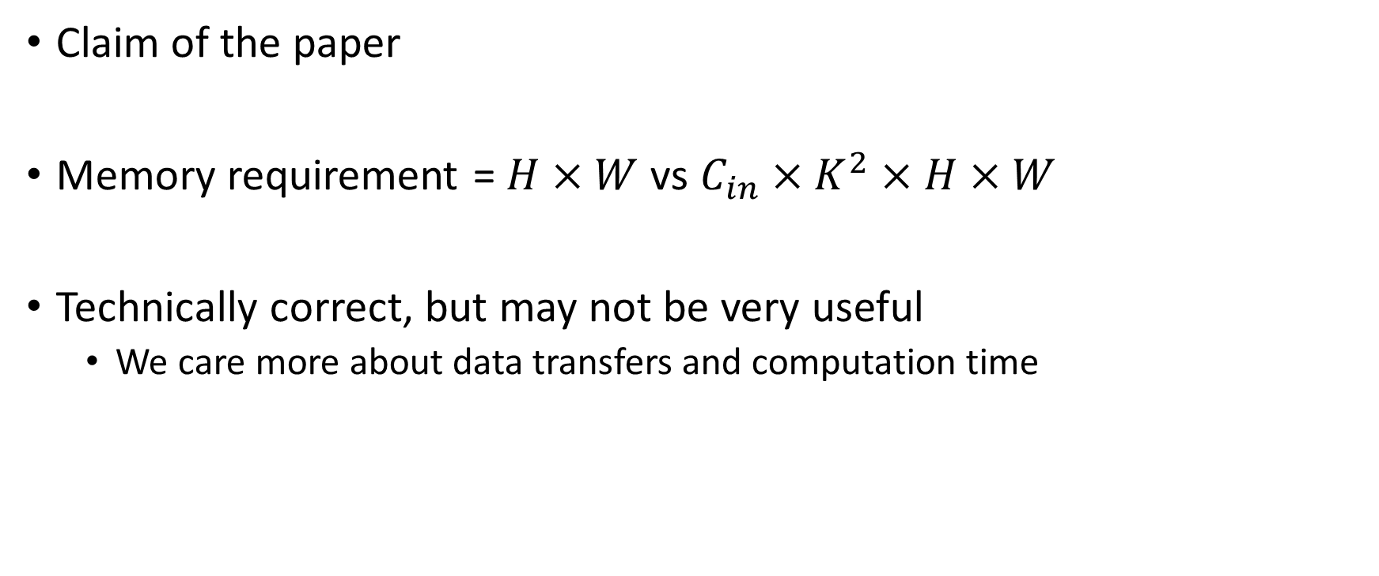
Scalar Matrix Multiplication
Claim of the paper
Memory requirement = $H×W$ vs $C_{in}×K^{2}×H×W$
Technically correct, but may not be very useful
We care more about data transfers and computation time

Slide 76
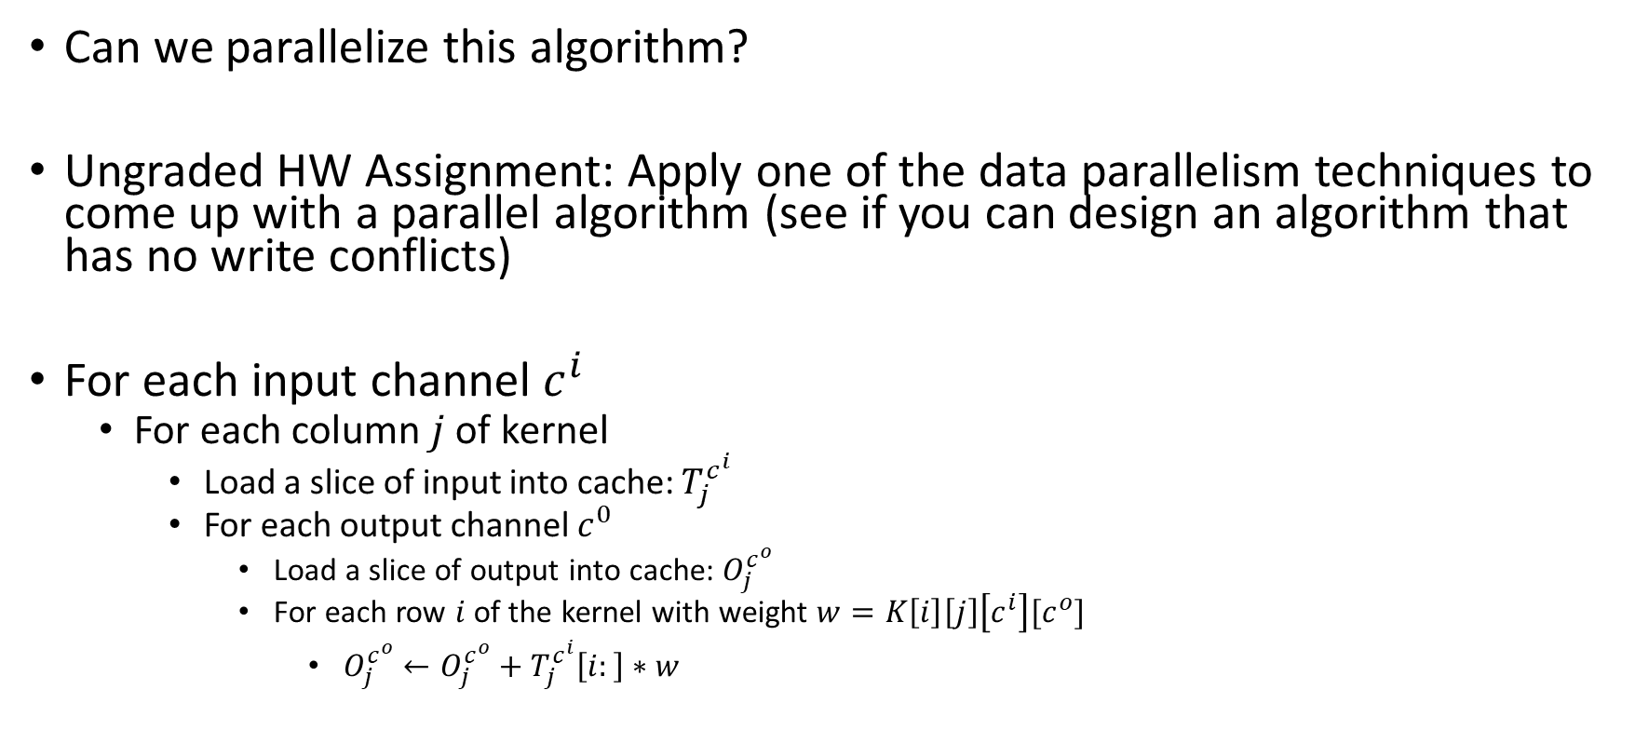
Scalar Matrix Multiplication
Can we parallelize this algorithm?
Ungraded HW Assignment: Apply one of the data parallelism techniques to come up with a parallel algorithm (see if you can design an algorithm that has no write conflicts)
For each input channel $c^{i}$
For each column $j$ of kernel
Load a slice of input into cache: $T_{j}^{c^{i}}$
For each output channel $c^{0}$
Load a slice of output into cache: $O_{j}^{c^{o}}$
For each row $i$ of the kernel with weight $w=K\left[i\right]\left[j\right]\left[c^{i}\right][c^{o}]$
$O_{j}^{c^{o}}←O_{j}^{c^{o}}+T_{j}^{c^{i}}\left[i:\right]∗w$

Slide 77
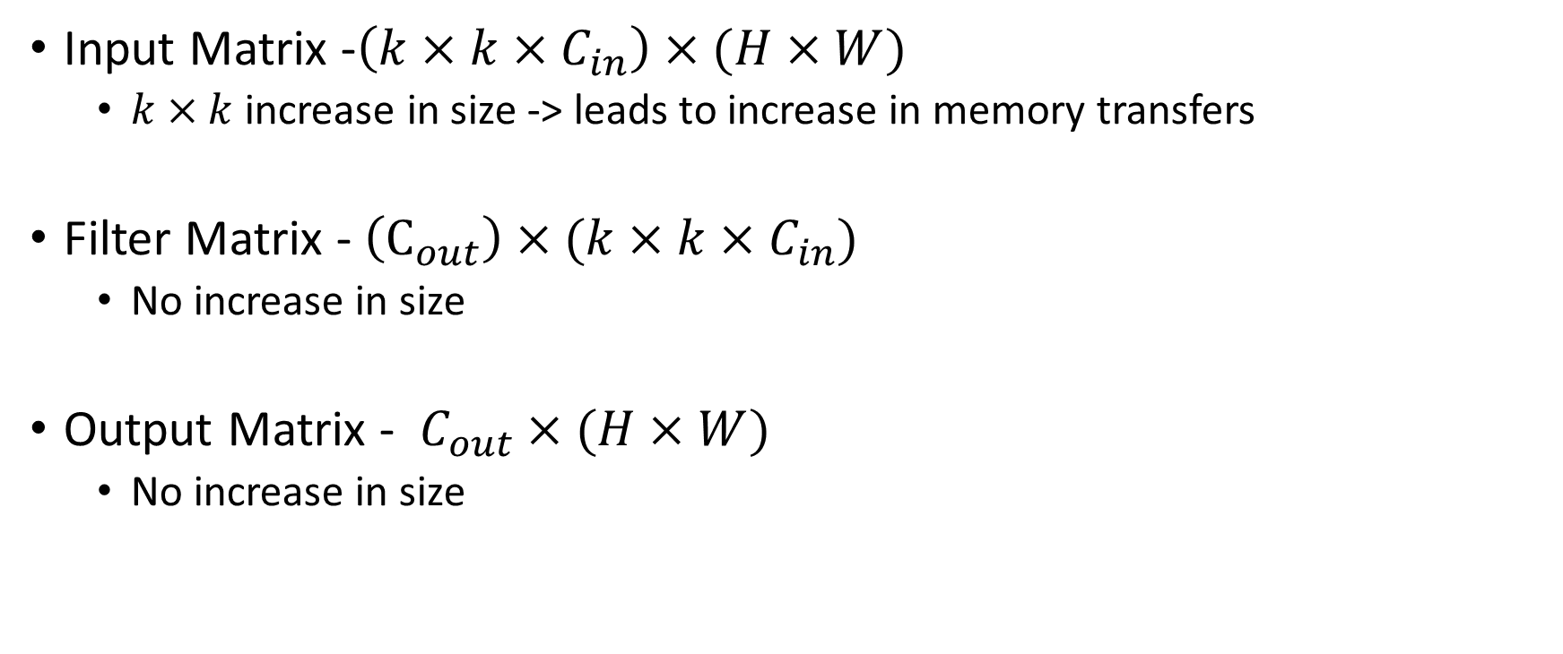
Im2Col Algorithm
Input Matrix -$\left(k×k×C_{in}\right)×(H×W)$
$k×k$ increase in size -> leads to increase in memory transfers
Filter Matrix - $\left(C_{out}\right)×(k×k×C_{in})$
No increase in size
Output Matrix - $C_{out}×(H×W)$
No increase in size

Slide 78
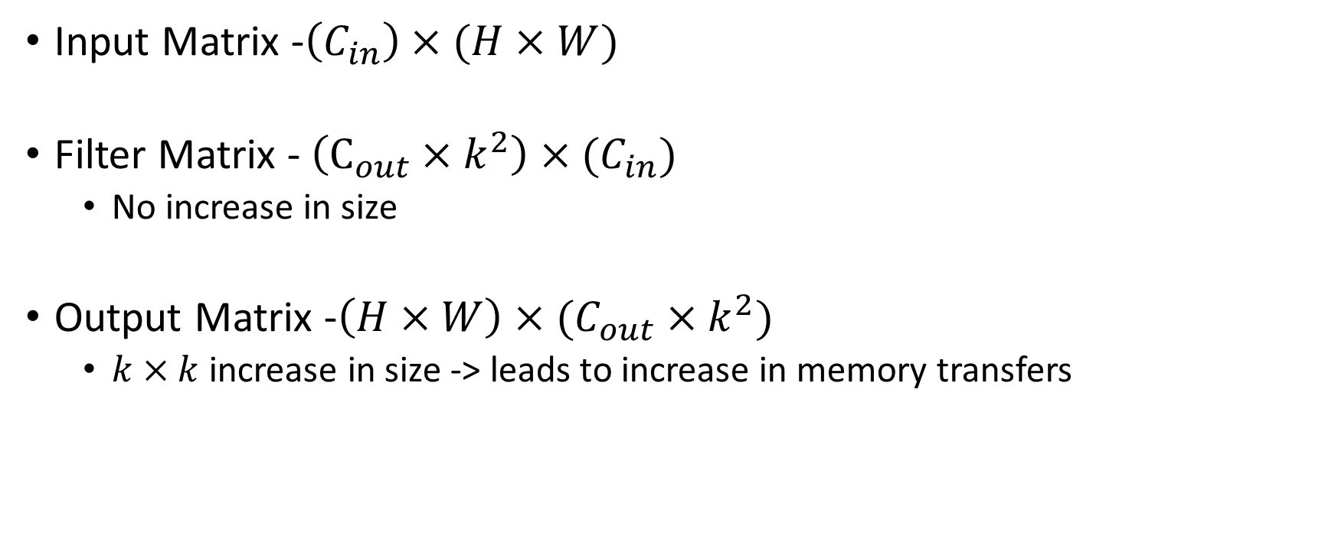
Kn2Row Algorithm
Input Matrix -$\left(C_{in}\right)×(H×W)$
Filter Matrix - $\left(C_{out}×k^{2}\right)×(C_{in})$
No increase in size
Output Matrix -$\left(H×W\right)×(C_{out}×k^{2})$
$k×k$ increase in size -> leads to increase in memory transfers

Slide 79
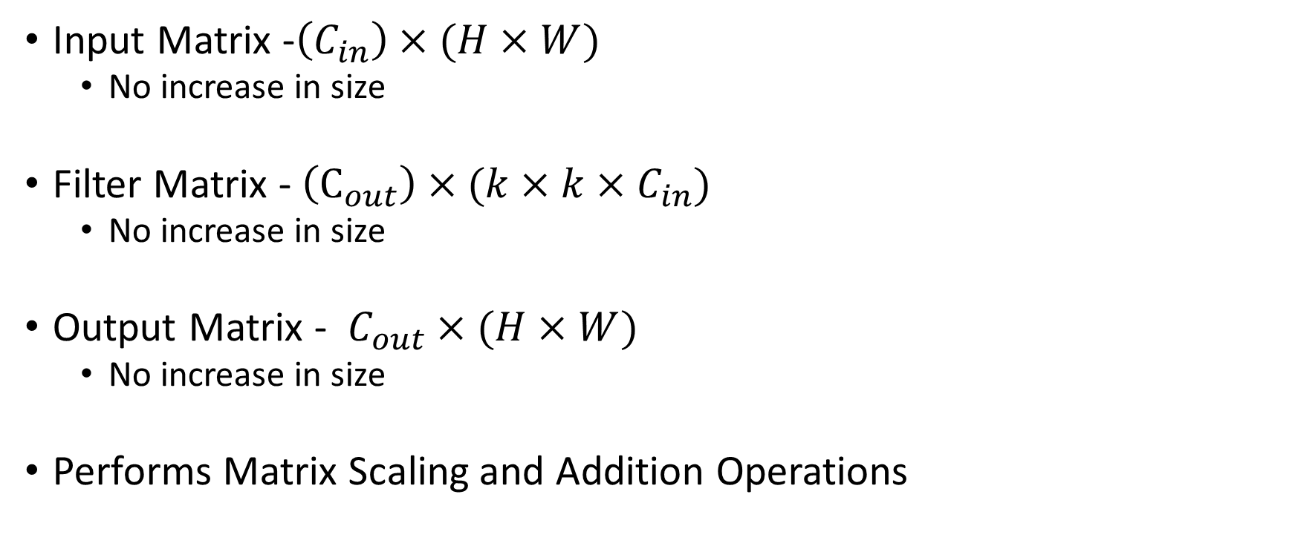
Scalar Matrix Multiplication
Input Matrix -$\left(C_{in}\right)×(H×W)$
No increase in size
Filter Matrix - $\left(C_{out}\right)×(k×k×C_{in})$
No increase in size
Output Matrix - $C_{out}×(H×W)$
No increase in size
Performs Matrix Scaling and Addition Operations

Slide 80
Next Class
9/30 Lecture 11
Accelerating Convolutional Neural Networks: Exploring Sparsity in Convolutional Neural Networks

Slide 81
Thank You
Questions?
Email: sanmukh.kuppannagari@case.edu

